Slide 1
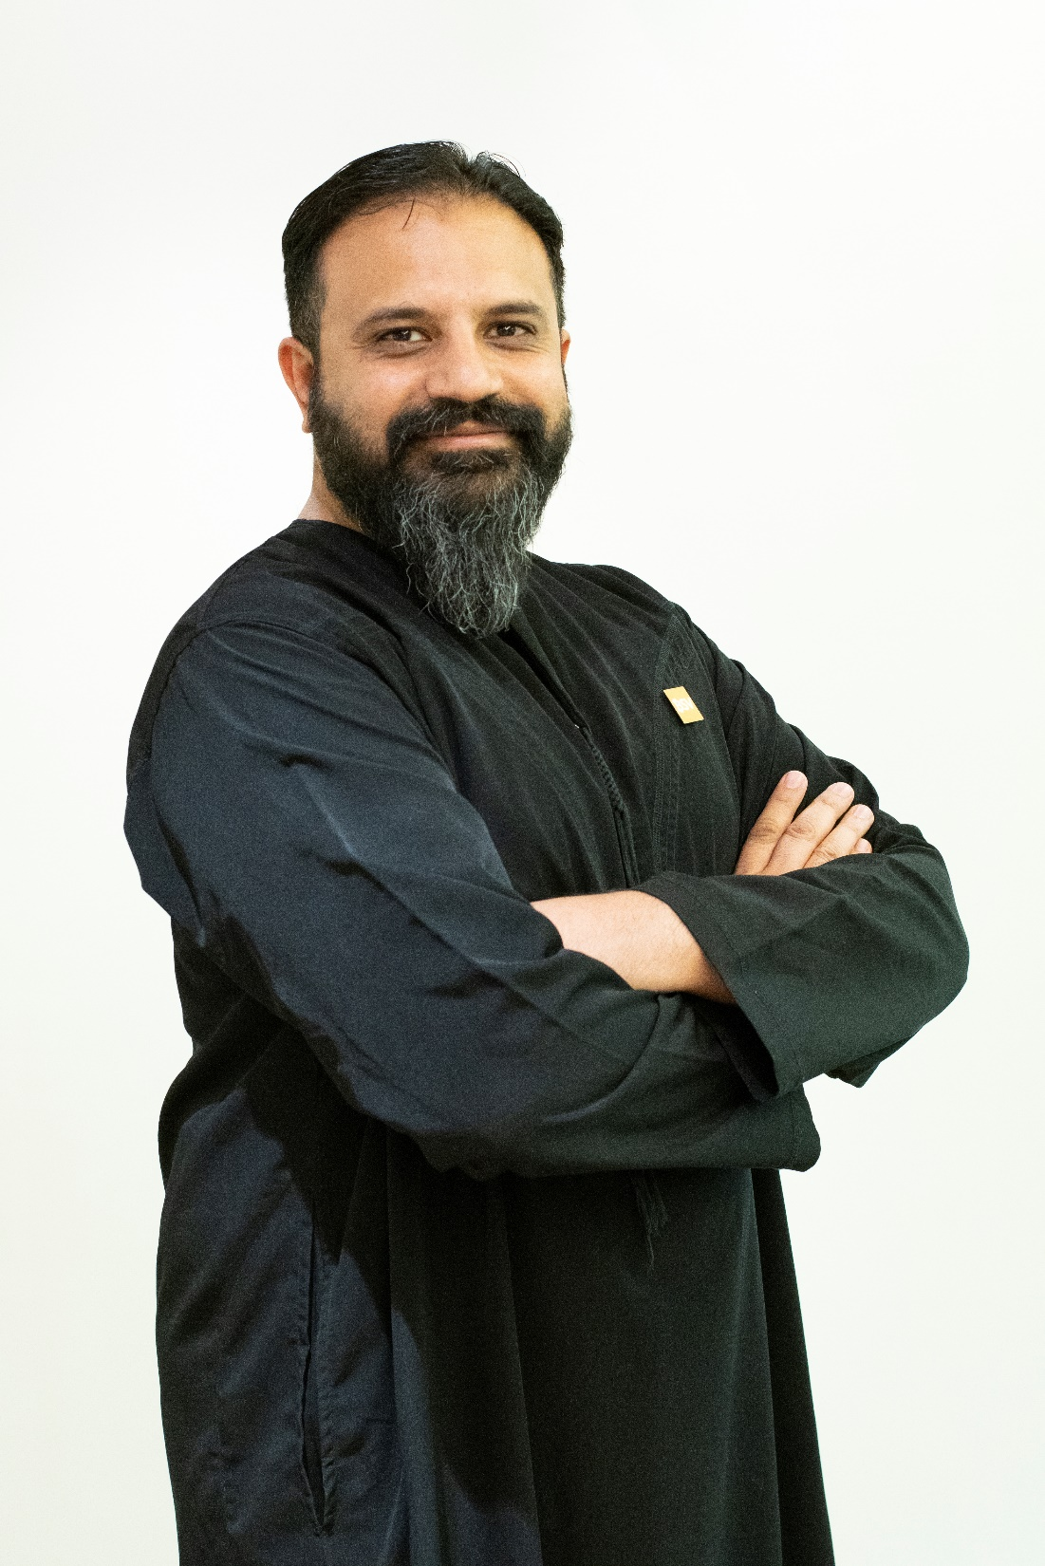
4th Global Takaful & Re-Takaful Forum
Islamic Banking & Takaful Powered by Blockchain
Muhammad Salman Anjum
Chief Mate @ InvoiceMate
Head BSV Hub MENA & South Asia
Aug 24, 2022
Dubai, UAE

Slide 2
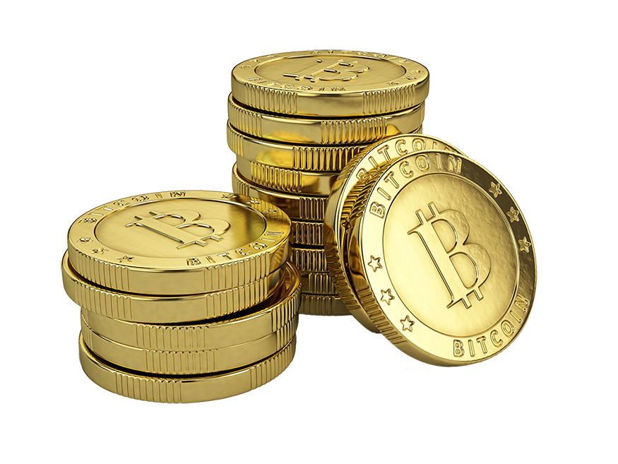
What’s Not In It
Notes:
When we hear about BC – what’s the next word or concept comes to your mind? Cryptocurrency
Nuts & Bolts of BC Technical side – more on strategic side

Slide 3
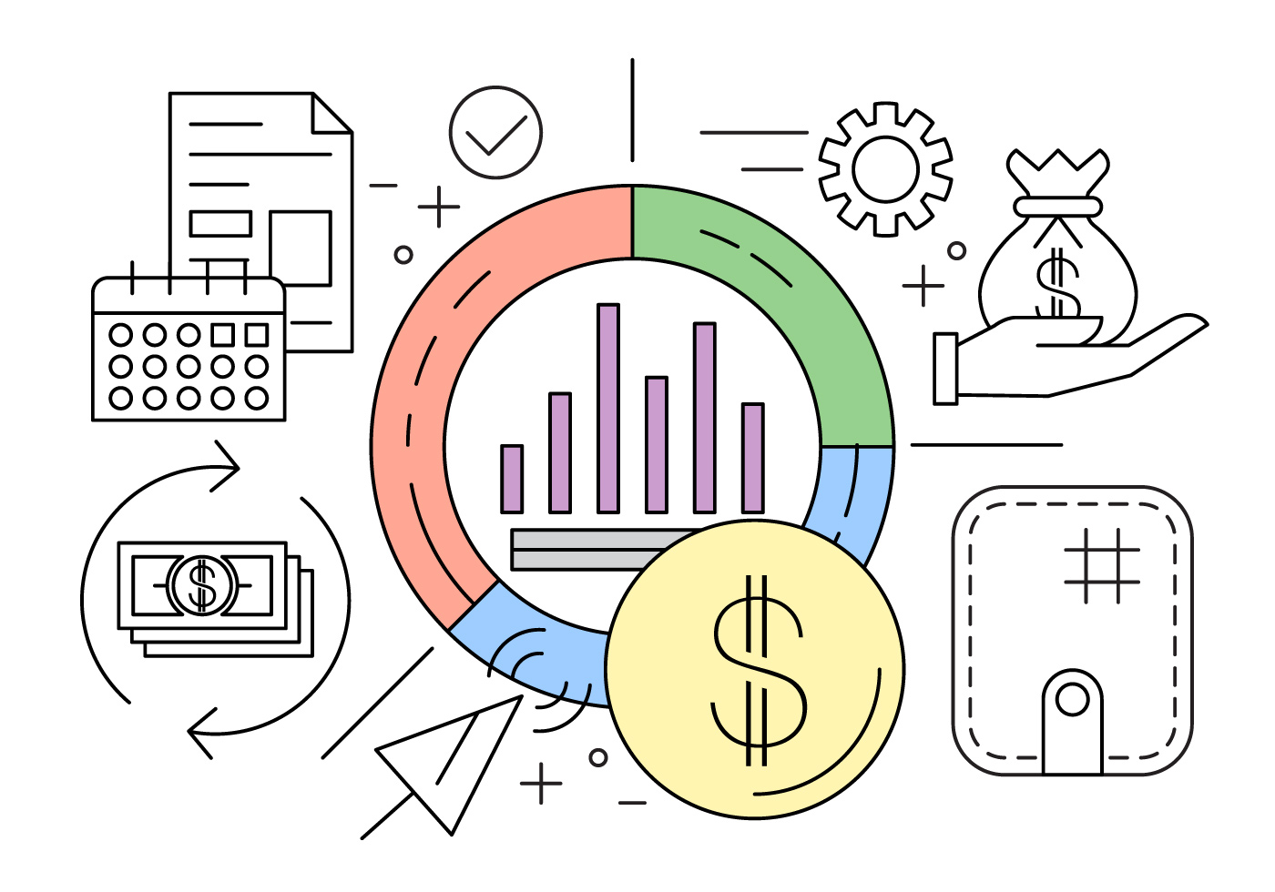
What’s In It

Slide 4
Chain of Discussion
Blockchain Adoption
Value of Blockchain for Islamic Banking & Takaful
Blockchain Use Cases for Islamic Banking & Takaful
Strategic Roadmap for Blockchain Adaptation
Blockchain Trailblazers in Islamic Banking & Takaful

Slide 5
Islamic Banking & Takaful Powered by Blockchain
Block 1
Blockchain Adoption

Slide 6
Journey So Far…
First consumer transaction happened for buying pizza
Blockchain regular part of Digital Transformation
Fraud & illicit behavior gains momentum
Blockchain 2.0 (Programmable Blockchain)
Block & Chain becomes “Blockchain”
Whitepaper got published
2008 | 2009 | 2010 | 2011 | 2012 | 2013 | 2014 | 2015 | 2016 | 2017-19 | 2020-22
First transaction happened in block #170
Emergence of Altcoins
Banks started exploring Blockchain
Bloomberg projection makes blockchain “Hot”
Start of Blockchain’s mainstream adaption

Slide 7
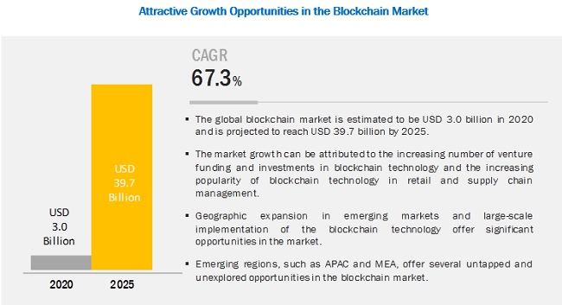
Blockchain Train Has Left the Station
Notes:
Numbers are very positive to show the bright future of Blockchain.
Global Blockchain spending expected to reach $9.2 billion, By 2021.
Blockchain spending in MEA to reach $307 million in 2021, which represents a compound annual growth rate (CAGR) of 77.4% for the 2016-2021 period.
86% of Financial Service Providers will be using Blockchain in their operations by 2020
240,000,000+ transactions on the Ethereum network since its inception.

Slide 8
Blockchain: The New Wave of Change

Slide 9
Islamic Banking & Takaful Powered by Blockchain
Block 2
Value of Blockchain for
Islamic Banking & Takaful

Slide 10
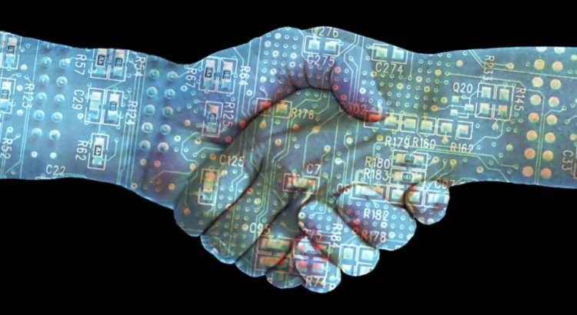
Primary Value of Blockchain
Giant Platform of Trust
Notes:
Put simply (with Bank of England’s words), the blockchain is “a technology that allows people who don’t know each other to trust a shared record of events”.

Slide 11
Blockchain for Islamic Banking & Takaful
A Perfect Match

Slide 12
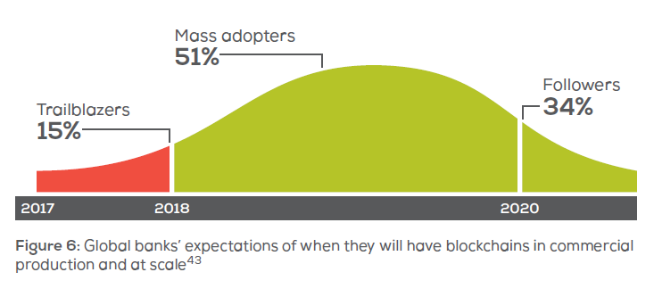
Blockchain & Financial Institutions: Love/Hate Story

Slide 13
Blockchain Benefits for Islamic Banking & Takaful
Fraud Prevention
Next Generation Automation
Blockchain
Benefits for Islamic FinTech
Regulatory Compliance
Authentic Data Driven
Decision Making
New Product Lines
New Payments Systems

Slide 14
Islamic Banking & Takaful Powered by Blockchain
Block 3
Blockchain Use Cases for
Islamic Banking & Takaful

Slide 15
Backend Operations for Islamic Banking & Finance
Marketing
& Sales
Accounting &
Finance
QA &
Compliance
Supply
Chain
Human
Resource

Slide 16
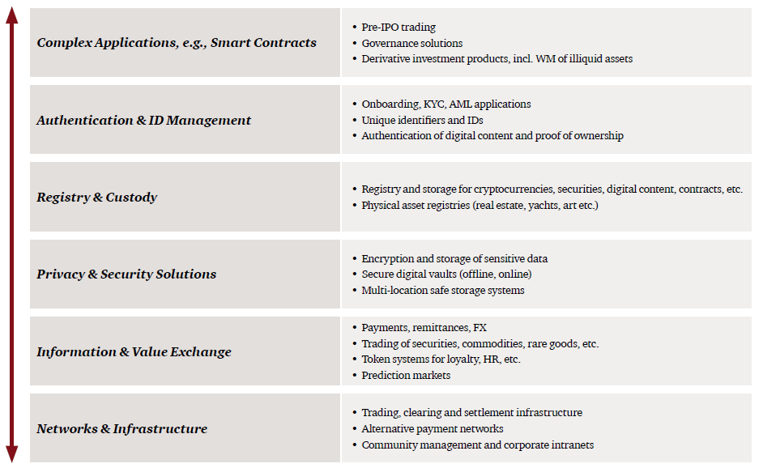
Functional Operations for Islamic Banking & Finance

Slide 17
Providing Financial Services to Unbanked Muslim Population
72% Muslims are Unbanked
Notes:
72% of Muslims are unbanked according to “The World Islamic Banking Conference Dec 2016”
integration with mobile technology in countries lacking legacy banking infrastructure.
By doing so ticking the SDG of United Nation. Increase outreach…

Slide 18
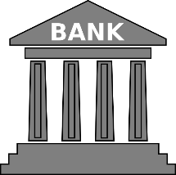
Resolving Uncertainty (gharar) in Transactions
Financial Regulatory
Authorities
Banks & Financial
Institutions
Religious Regulatory
Authorities
Users/Clients
Notes:
Through smart contracts automation of the entire contractual process for Islamic institutions, alleviating the additional administrative and legal complexities and redundancies associated with Sharia-compliant financial products.
verification of Islamic financial transactions for banks and customers to avoid conflicts, and facilitate client partnerships and increased transparency.
impenetrability, making it difficult to compromise as everything is tracked on a ledger which stops people from spoofing it or creating fake data.

Slide 19
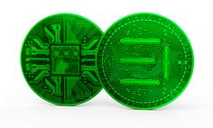
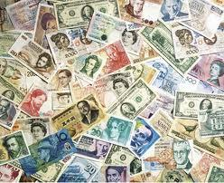
Currency Compliant with Islamic Concepts
Islamic Concept of Currency
Money is considered as medium of exchange and measurement of economic value. However, it is not a type of commodity that can be traded and expect a return of it without engaging it in a productive activity
Since “dissolvent of “Bretton Woods Agreement” the fiat money issued holds no intrinsic value rather than it is backed by the trust of the public in their government ability to control its circulation to achieve economic stability and prevents high inflation causing the currency to devaluate.
This issue leads to questioning the ability of fiat money to be considered compatible to Islamic requirements in a currency.
However, until this day, fiat money proved its inability to be a store of value which is one of the primary functions of money.

Slide 20
Sukuk (Islamic Fundraising Bonds)
1- Increase the transparency of cash flows & the underlying assets,
2- Enhancing investors’ decision-making through a greater & authentic supply of information.
3- Also facilitate Sharia and financial auditing of sukuk after issuance, thereby reducing the risk of default.
Notes:
S&P Global Ratings believes blockchain and smart contract protocols could change the global sukuk industry for the better.
1- Increase the transparency of cash flows & the underlying assets,
2- Enhancing investors’ decision-making through a greater & authentic supply of information.
3- Also facilitate Sharia and financial auditing of sukuk after issuance, thereby reducing the risk of default because of non-Sharia compliance.

Slide 21
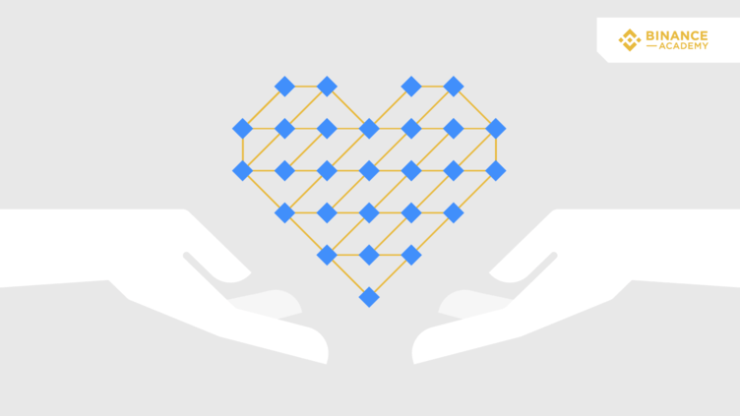
Administration of Zakat & Waqf
Blockchain helps people know where there money is going, and to what purpose.
Efficient, Low Cost & Transparent Governance
Notes:
Zakat: Obligatory charity; and one of the five pillars of Islam. Due to its importance, it is mentioned thirty-two times in the Quran. T
Waqf: Trust
Total transparency – global – reduced expenses

Slide 22
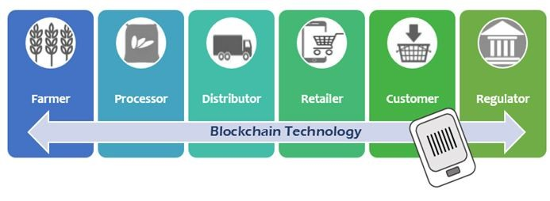
Halal Supply Chains
Food, Cosmetics, Home Care, Pharmaceuticals
Provenance, Trackability, Seamlessness & Sustainability
Notes:
According to statistics, the global Halal market value that is recorded at approximately 1.4 trillion USD in 2017 is expected to reach 2.6 trillion USD in 2023.

Slide 23
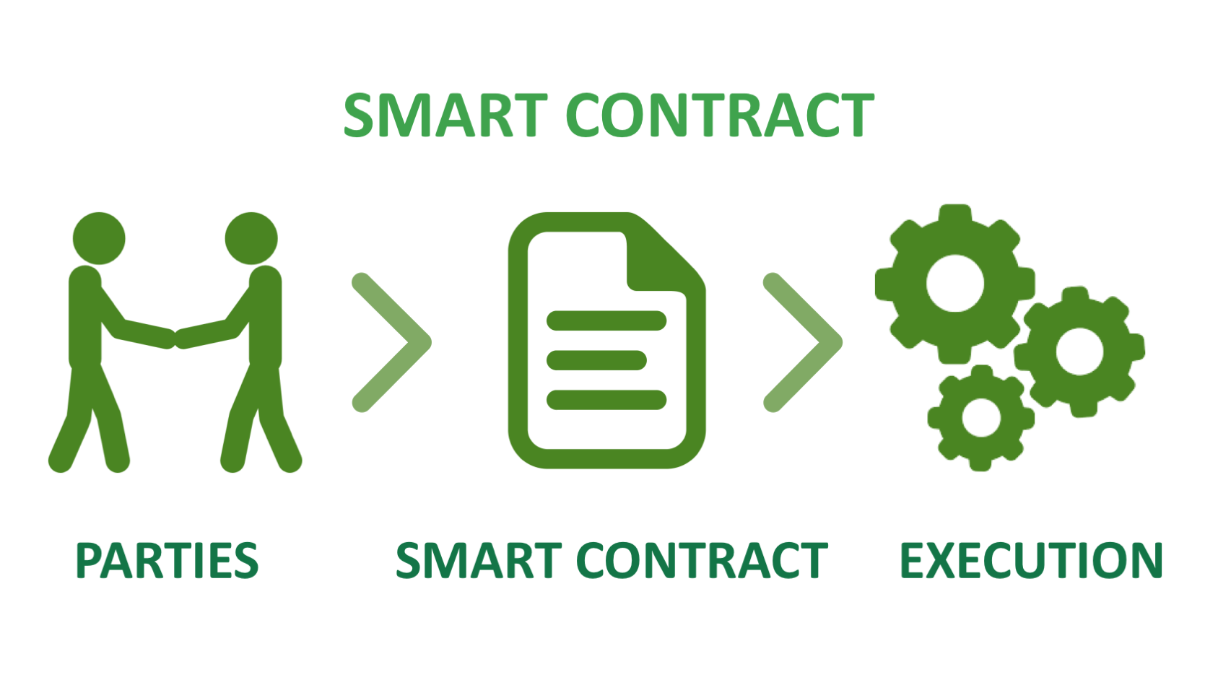
Written Commercial Agreements & Contracts
The Quranic verses (Surah Al-Baqarah: 282–283) enjoin Muslims to put contracts in writing for fairness and accountability.
Smart contracts are self-executing contracts that have the terms and conditions of the agreement written into lines of code.
The code exists across a distributed, decentralized blockchain network, cutting out the need for third parties to administer the contract.
Notes:
record mutually agreed upon terms for execution or dispute resolution.

Slide 24
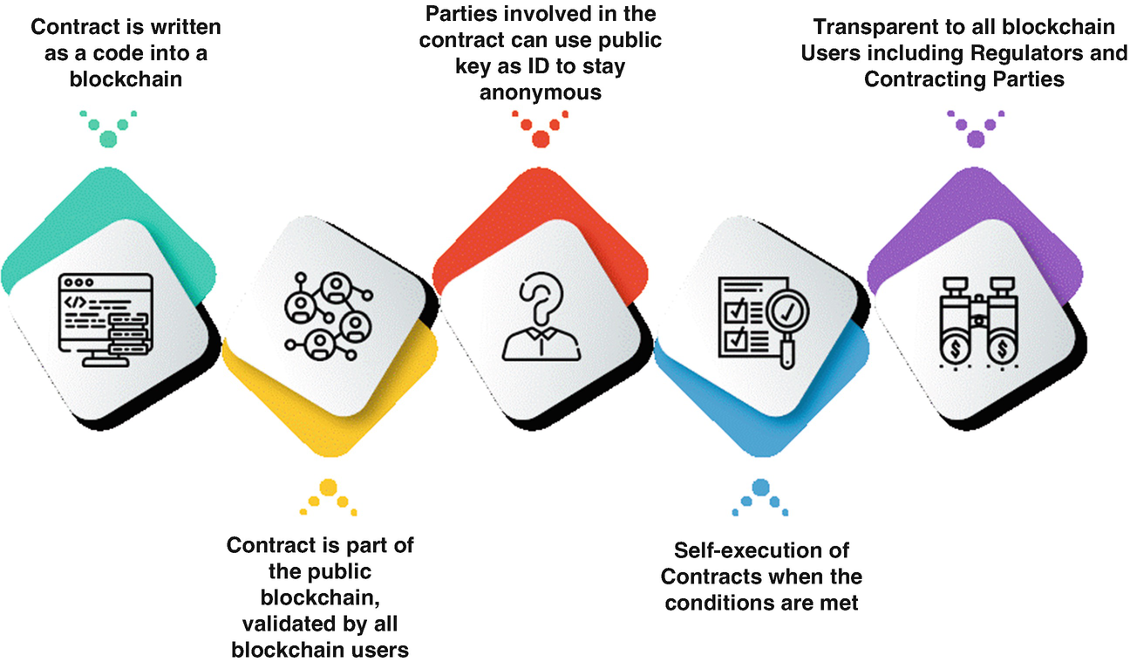
Smart Contracts for Automated Shariah Compliance
Create Sharia-compliant financial products and automate the entire contractual process for Islamic institutions.
Easy to verify, immutable, and secure, also alleviate additional administrative and legal complexities and redundancies associated with Shariah compliant financial products.
Notes:
back-office automation: Blockchain based smart contracts to create Sharia-compliant financial products and automate the entire contractual process for Islamic institutions. Not only are these blockchain smart contracts easy to verify, immutable, and secure, but they also alleviate additional administrative and legal complexities and redundancies associated with Shariah compliant financial products.

Slide 25
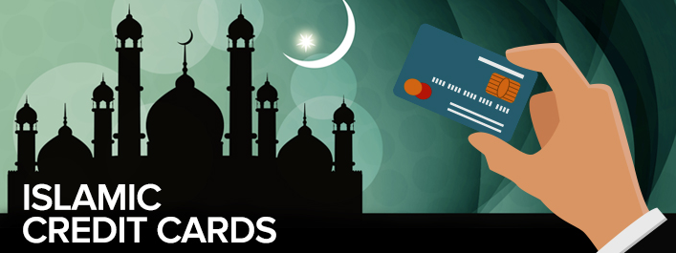
Islamic Credit Cards
By using Blockchain based systems, the card could be obstructed from paying for wrongful purchases but allowed to pay for other items.

Slide 26
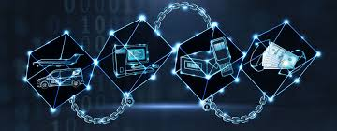
Takaful (Islamic Insurance)
Blockchain can be used as a cross-industry, distributed registry with external data and customer data to:
– Confirm authenticity, ownership, and origin of goods as well as the legitimacy of documents (e.g., medical reports)
– Check for police reports indicating theft, claims history as well as a person’s verified identity and expose patterns of deception related to a person or identity
– Proof of date and time stamps of policy issuance or purchase of a product/ asset
– Validate ownership and site changes
Notes:
By moving insurance claims onto an immutable ledger, blockchain can help eliminate common sources of fraud in the insurance industry. A shared ledger and insurance policies executed through smart contracts can bring an order of magnitude improvement in efficiency to property and casualty insurance.

Slide 27
Islamic Banking & Takaful Powered by Blockchain
Block 4
Blockchain Trailblazers in
Islamic Banking & Takaful Industry

Slide 28
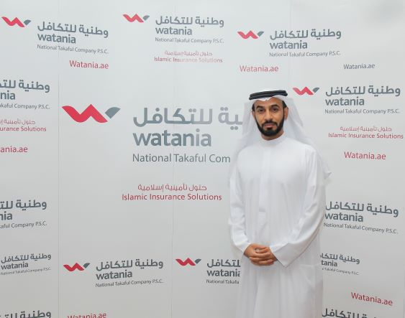
Watania
Entities Involved | Watania
Features | Managing the recovery process for motor claims from other insurance companies. Bringing down the time and material involved in processing such transactions.
Notes:
Emirates Islamic’s security enhancement feature, called Cheque Chain, involves the bank issuing new cheque books carrying a unique quick response (QR) code on every leaf along with 20 random characters. The next phase of the project will see the bank registering each cheque leaf on its blockchain platform to validatethe authenticity of the cheque at source.

Slide 29
Addenda Blockchain Insurance Platform
Entities Involved | Aman Insurance, National Insurance Company, Al Wathba Insurance, Noor Takaful, Oriental Insurance
Features | By using blockchain, parties can share the data, doing away with the need for reconciliation. Insurance tasks are reported on their system in real-time. Each action is recorded immutably on the blockchain, so any policy changes are accountable and verifiable.
Notes:
The nature of insurance lends itself to DLT. Most policies involve at least a broker, an insurer and a reinsurer. For more substantial policies there are often even more parties and so even more data to keep in sync. Every time there’s a claim or policy change, all the organizations have to reconcile to make sure they have the same information.

Slide 30
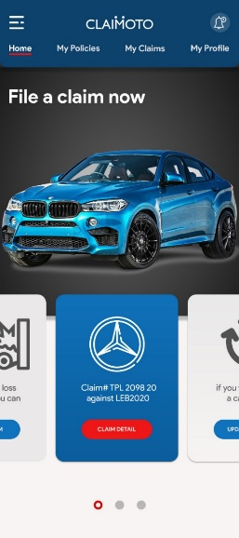
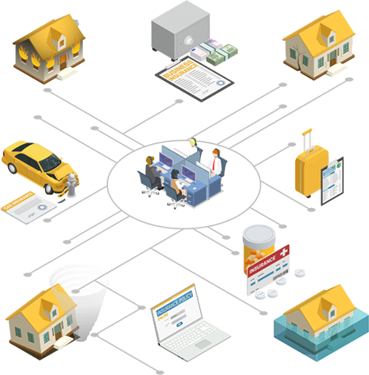
Claimoto
Entities Involved | SPL, MateSol & BSV Blockchain
Features | The purpose of this solution is to automate the end-to-end claims handling process of motor claims by using the advanced technologies and bring digital transformation & best practices to industry. It is to improve customer satisfaction, reduce manual work and reduce trust deficiencies in process.

Slide 31
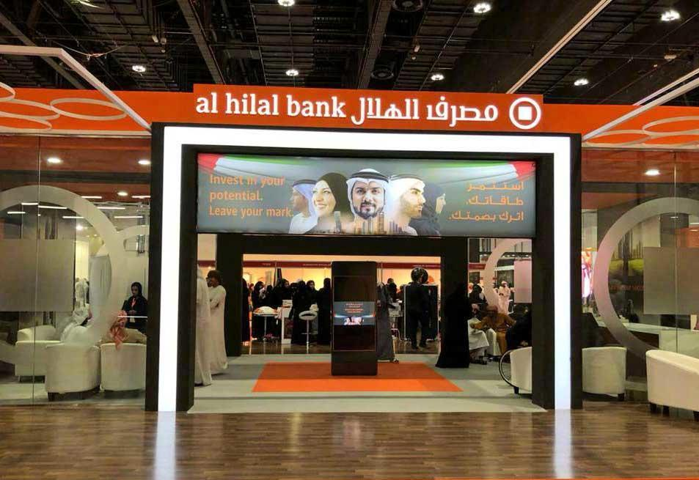
Smart Sukuks
Entities Involved | Al Hilal Bank, ADGM, Jibrel Network
Features | Al Hilal Bank has become the world’s first Islamic bank to use Blockchain technology for the resale and settlement of an Islamic Sukuk (Sharia-compliant bond). It was used to transact a secondary market deal in Al Hilal Bank’s $500m Senior Sukuk maturing in September 2023. The advantages of using Blockchain range from safer transactions with robust Shariah compliance, to the unlocking of new opportunities.
Notes:
Blockchain was used to transact a secondary market deal in Al Hilal Bank’s $500 million Senior Sukuk maturing in September 2023.

Slide 32
Waqf Chain
Entities Involved | Finterra
Features | It allows Waqf bodies, NGOs, Corporate CSRs, Trusts and other stakeholders with the opportunity to create or fund causes, submit project outlines / plans which are required to fund Waqf and/or Charitable projects and causes. Each project has its own Smart Contract standard under the ERC-777. These Smart Contracts are placed into a project fundraising which only can be started once all due diligence requirements have been passed.

Slide 33
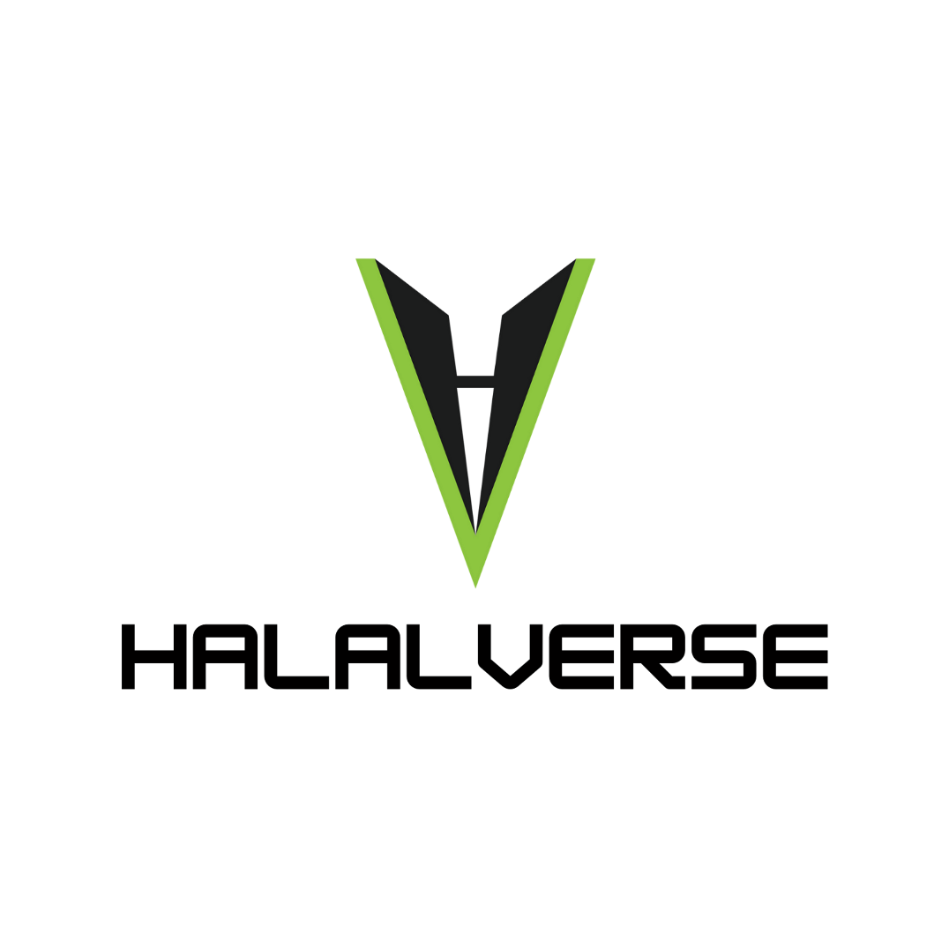
Halalverse
Entities Involved | Vostad, MateSol, PayScript
Features | Halalverse is an initiative to create an open space for acquiring and sharing knowledge free from temporal and spatial limitations. It is to feature all the Halal Web 3.0 projects and make them accessible for investment to the global Muslim community.

Slide 34
InvoiceMate
Entities Involved | MateSol & BSV
Features | InvoiceMate is designed to strengthen trust and automation at each point of the invoice processing & financing process. First of its kind application that enables conventional businesses to reach out to growing crypto liquidity for Invoice Financing which is third largest financing mean for businesses.
A Bridge Connecting
Conventional Businesses with
Islamic Invoice Financing

Slide 35
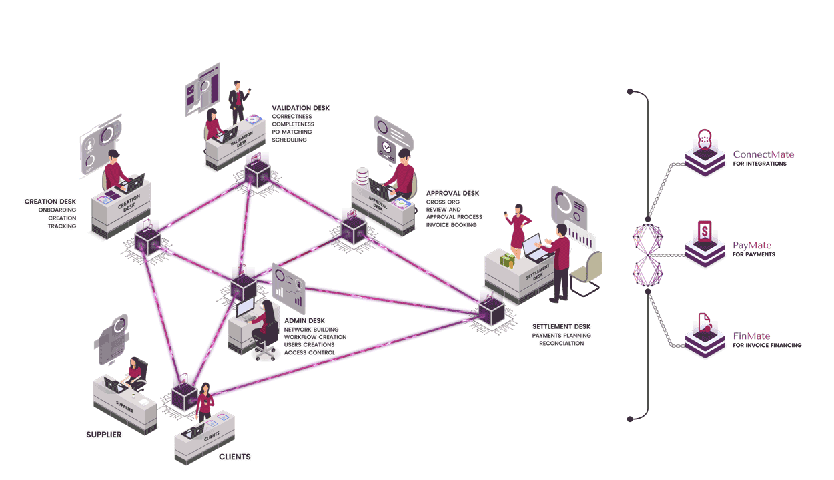
InvoiceMate – Next Generation Invoicing Ecosystem

Slide 36
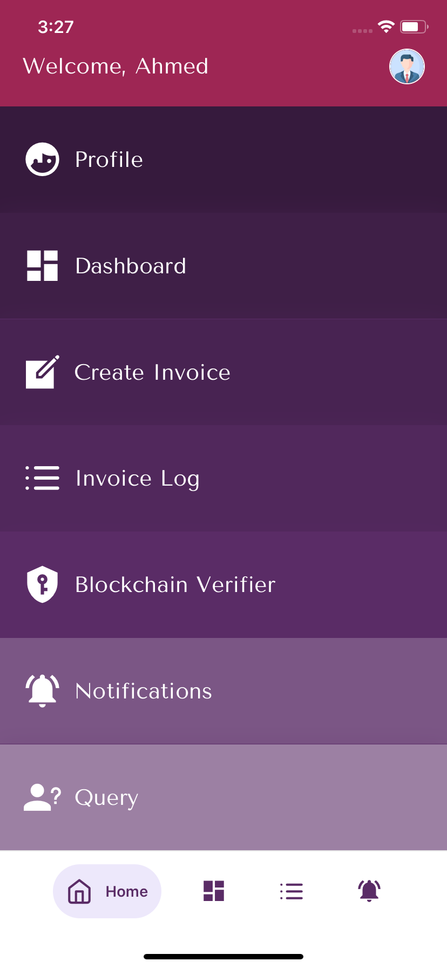
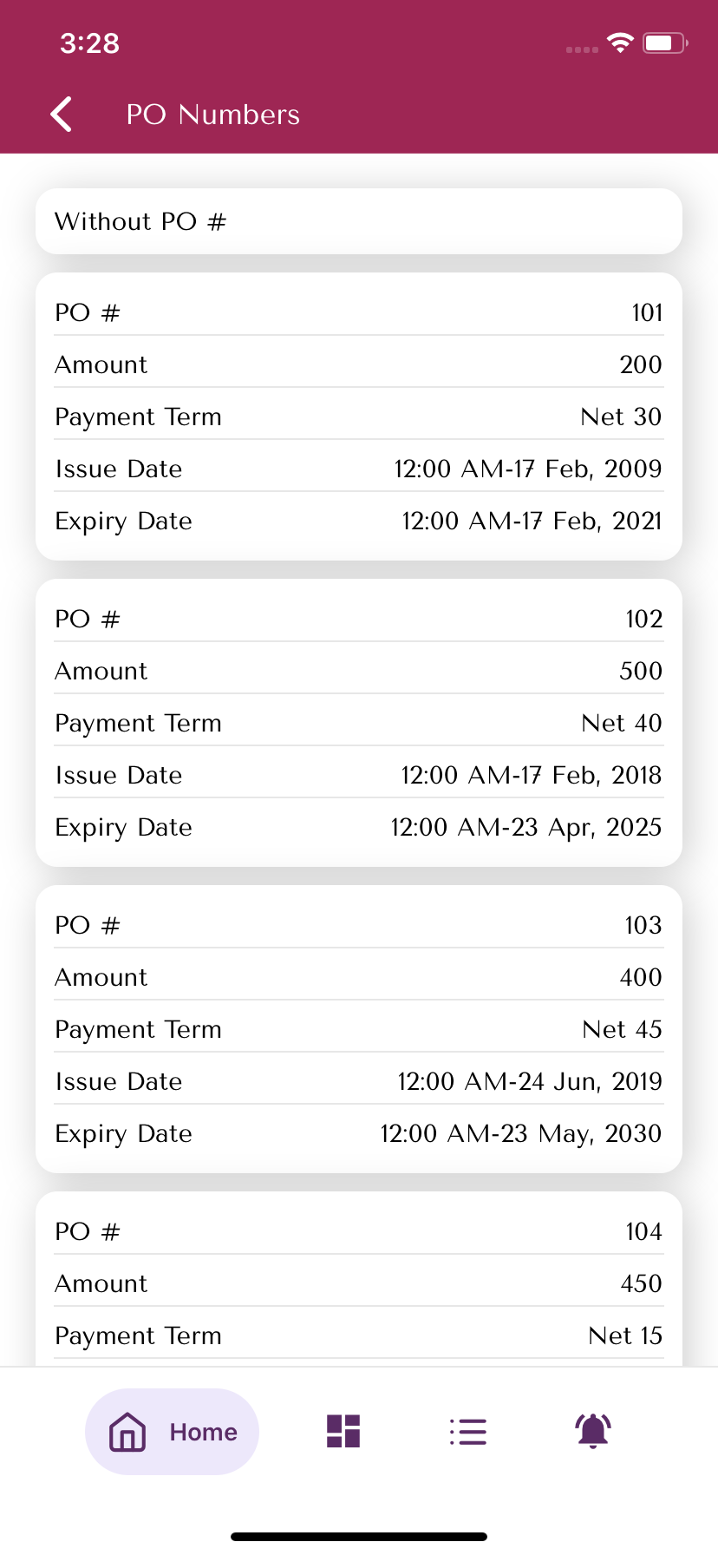
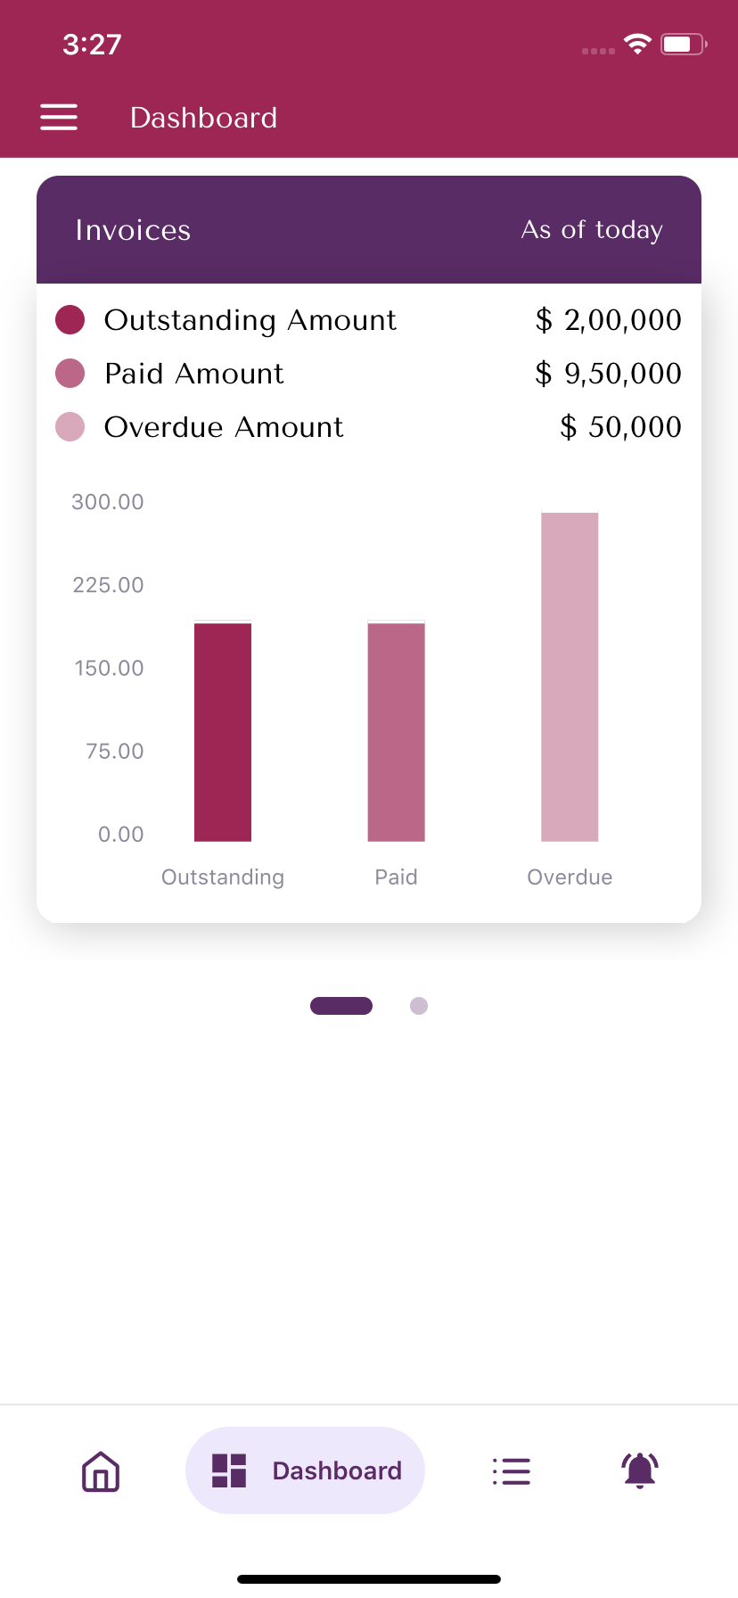
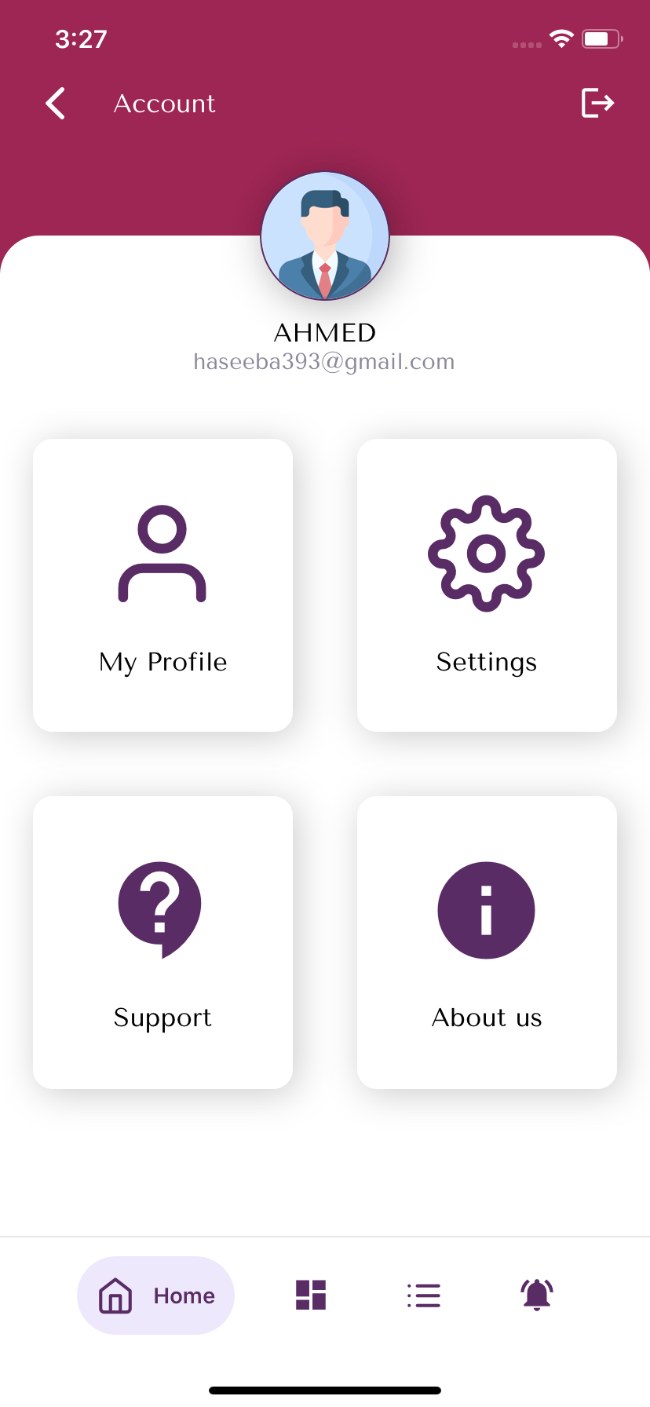
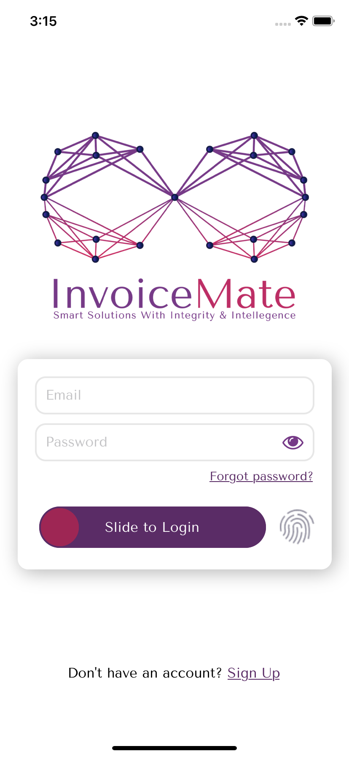
InvoiceMate – Pro & Lite Versions

Slide 37
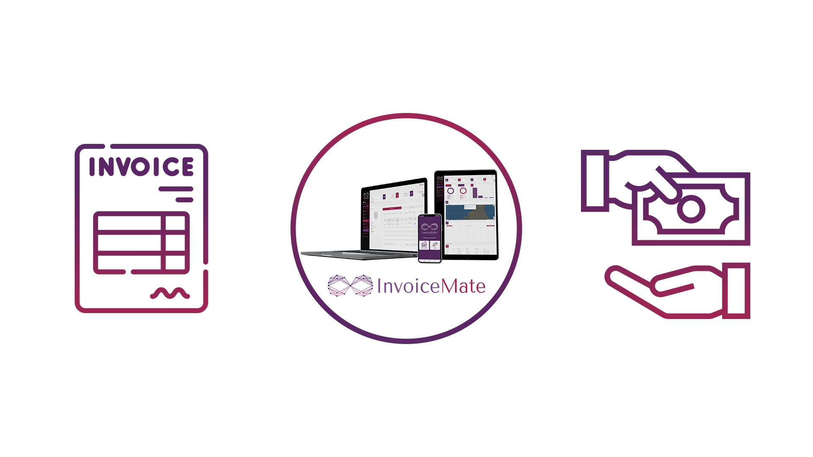
InvoiceMate – Islamic Invoice Financing
InvoiceMate is building an entirely new ecosystem that provides shariah complaint liquidity to SMEs that are not able to get invoice financing from traditional institutions.

Slide 38
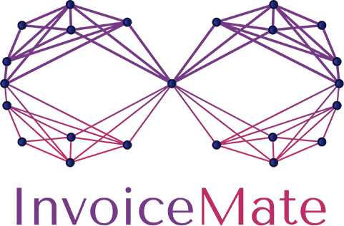
InvoiceMate – Institutional Partnerships
Integration as Payment Channel in InvoiceMate | Collaboration for Trusted Invoice Financing | Integration of InvoiceMate as Digital Payment System

Slide 39
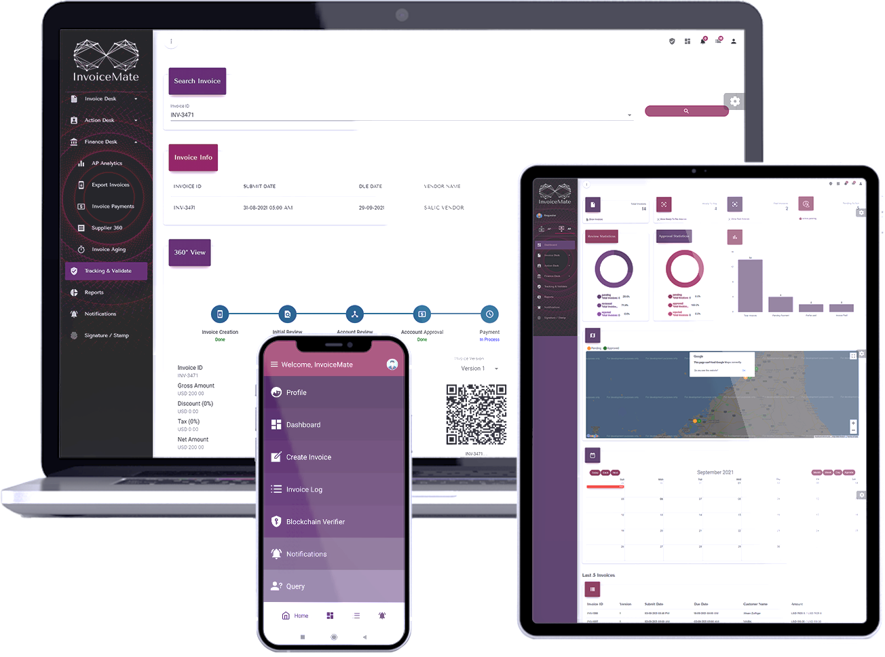
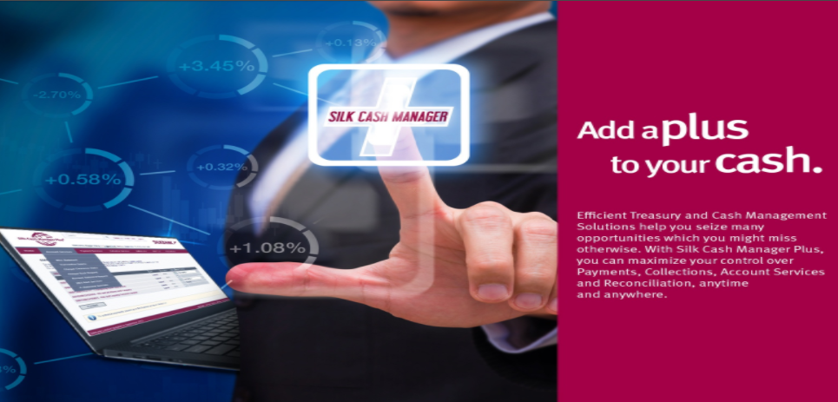
InvoiceMate – Institutional Partnerships
Ordinance Compliance
Optimum CX
Enhanced Adoption
Data Analytics
No Duplication of Work
Clearance Load Management

Slide 40
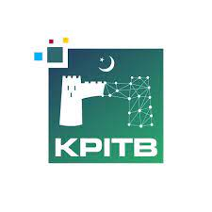
InvoiceMate – Institutional Partnerships
Islamic Invoice Financing for KPK Government Vendors

Slide 41
InvoiceMate – Institutional Partnerships
Cloud Integration
Jazz Cash Integration
Implementation Partnership

Slide 42
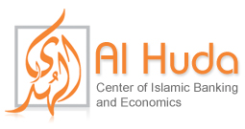
InvoiceMate – Institutional Partnerships
Islamic Invoice Financing Advisory
Implementation Partner

Slide 43
Islamic Banking & Finance in Blockchain Era
Block 5
Strategic Adoption for
Blockchain in Islamic FinTech

Slide 44
Challenges for Blockchain Adaption
Change Resistance
Integration &
Interoperability
Lack of
Blockchain Expertise
Network
Effect
Myths Around
Blockchain
Notes:
Let’s see some of these challenges that also forms opportunities for creativity
Lack of Regulations & Mushroom Growth
Network Effect
Integration & Interoperability
Novelty & Scalability
Security Issues (It takes a very different approach to data storage and processing and requires a very different perspective for security.)
Creative Direction for Solution Designing

Slide 45
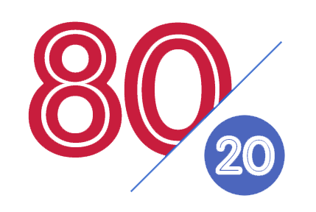
Implementing Blockchain
Implementing the Blockchain is "80% Business Process / 20% Technology"
[it’s not the other way around]

Slide 46
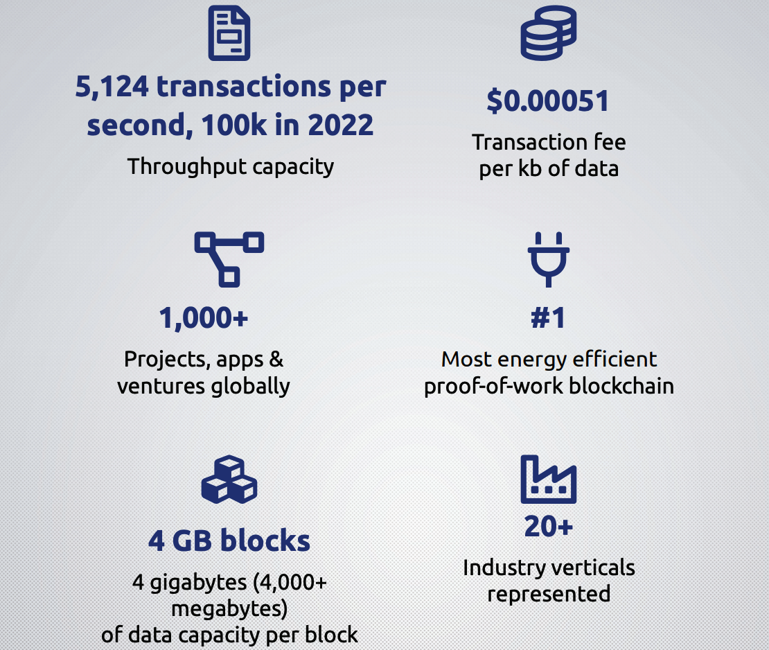
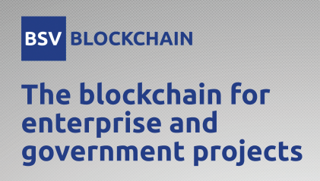
BSV Blockchain

Slide 47
Blockchain is Not a Problem Looking for a Solution

Slide 48
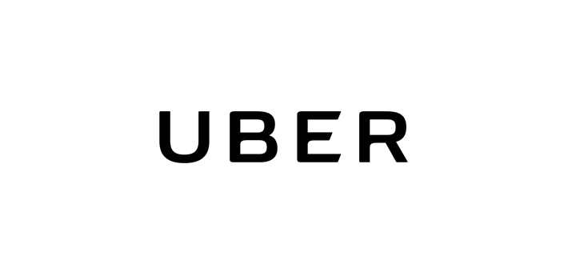
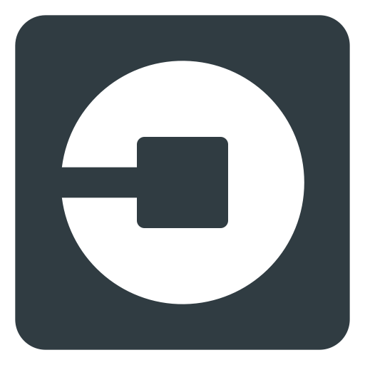
Blockchain is a Solution Looking for Problems
Future
Future
Future
Future
Future
Future

Slide 49
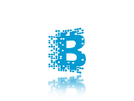
Blockchain is Magical… But

Slide 50
Islamic Banking & Takaful Powered by Blockchain
Thanks!
salman@bsvblockchain.org & salman@matesol.net

